Slide 1
Machine learning in physics Transformers

Slide 2
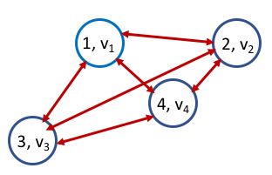
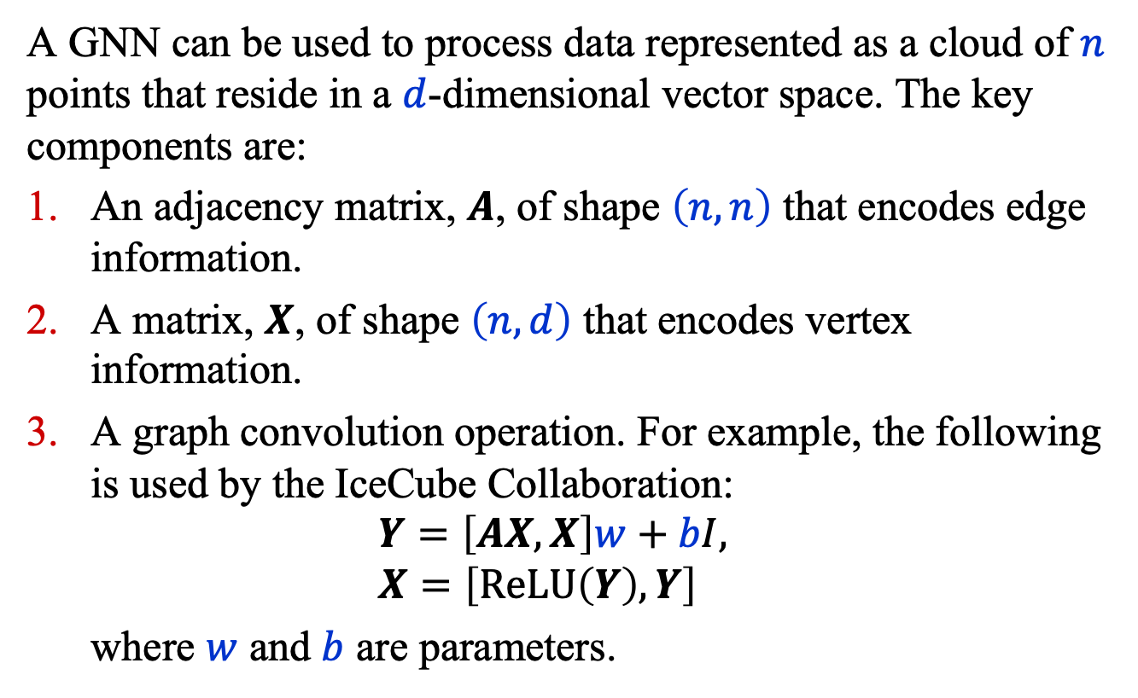
Recap: Graph Neural Networks
A GNN can be used to process data represented as a cloud of $n$ points that reside in a $d$-dimensional vector space. The key components are:
An adjacency matrix, $A$, of shape $\left(n, n\right)$ that encodes edge information.
A matrix, $X$, of shape $\left(n, d\right)$ that encodes vertex information.
A graph convolution operation. For example, the following is used by the IceCube Collaboration:
$$Y=\left[AX, X\right]w+bI, \\ X=\left[\text{ReLU}\left(Y\right), Y\right]$$
where $w$ and $b$ are parameters.

Slide 3
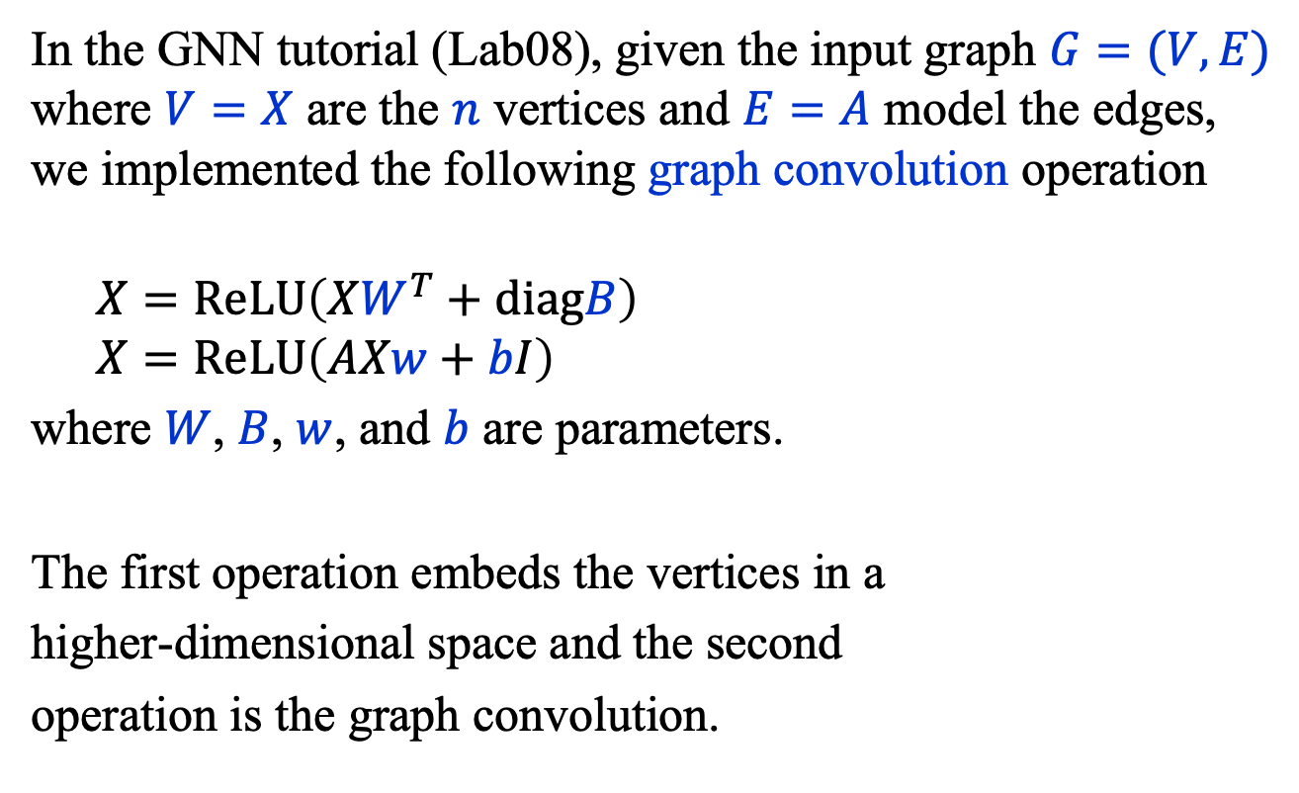
Recap: Graph Neural Networks
In the GNN tutorial (Lab08), given the input graph $G=(V, E)$ where $V=X$ are the $n$ vertices and $E=A$ model the edges, we implemented the following graph convolution operation
$$X=ReLU\left(XW^{T}+diagB\right)$$
$$X=ReLU\left(AXw+bI\right)$$
where $W$, $B$, $w$, and $b$ are parameters.
The first operation embeds the vertices in a
higher-dimensional space and the second
operation is the graph convolution.

Slide 4
Introduction
Convolutional neural networks (CNN)
Autoencoder (AE)
Physics-informed neural networks (PINN)
Flow and diffusion models
Graph neural networks (GNN)
Transformer neural networks (TNN)

Slide 5
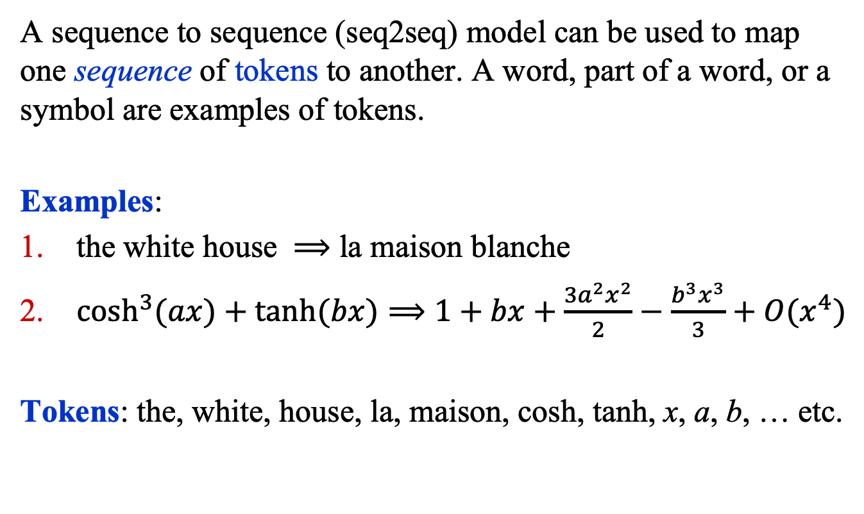
Sequence to Sequence Models
A sequence to sequence (seq2seq) model can be used to map one sequence of tokens to another. A word, part of a word, or a symbol are examples of tokens.
Examples:
the white house $⟹$ la maison blanche
$\cosh^{3}{(ax)}+\tanh{(bx})⟹1+bx+\frac{3a^{2}x^{2}}{2}−\frac{b^{3}x^{3}}{3}+O(x^{4})$
Tokens: the, white, house, la, maison, cosh, tanh, x, a, b, … etc.

Slide 6
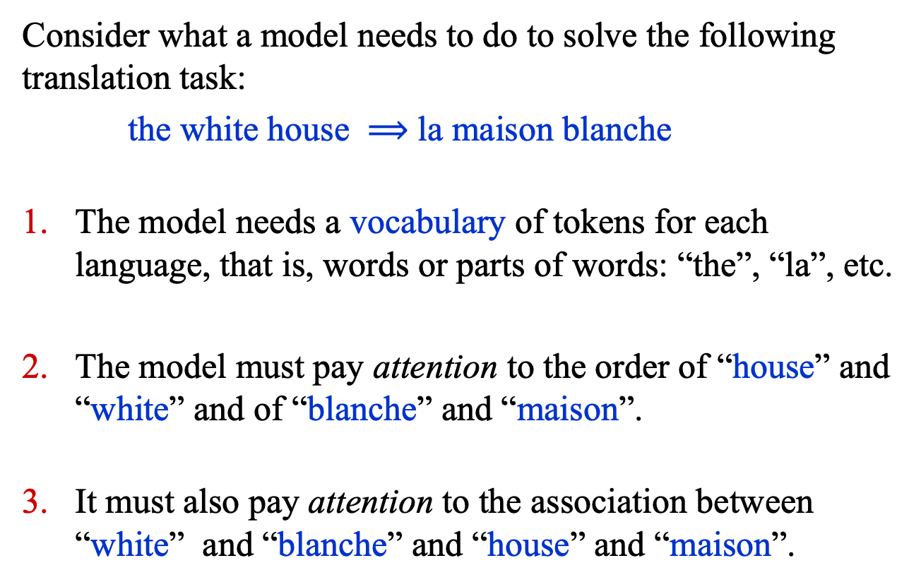
Sequence to Sequence Models
Consider what a model needs to do to solve the following translation task:
the white house $⟹$ la maison blanche
The model needs a vocabulary of tokens for each language, that is, words or parts of words: “the”, “la”, etc.
The model must pay attention to the order of “house” and “white” and of “blanche” and “maison”.
It must also pay attention to the association between “white” and “blanche” and “house” and “maison”.

Slide 7
Seq2Seq Models: Steps
A seq2seq model generally implements the following steps.
Tokenization: splitting a sequence into tokens.
Coding: assigning a unique integer to each unique token.
Embedding: representing each token by a vector.
Analysis: analyzing the input (source) sequence.
Synthesis: constructing the output (target) sequence.

Slide 8
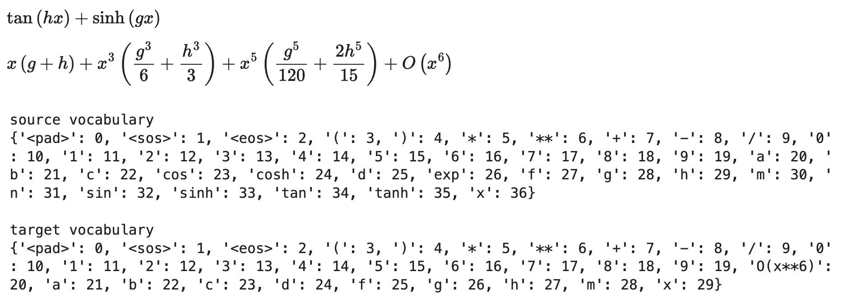

Seq2Seq: Tokenization
The sequence $x=\tan\left(hx\right)+\sinh{(gx)}$ can be split into the tokens tan, (, h, x, ), +, sinh, (, g, x, and ).
The set of unique tokens is called a vocabulary.
Example:

Slide 9

Seq2Seq: Coding/Padding
Since machines work with numbers it is necessary to map every token in a sequence to a number (e.g., an integer).
Example: $x=\tan\left(hx\right)+\sinh{(gx)}$ is mapped to
$x=34, 3, 29,36,4, 7,33,3,28,36,4$

Slide 10

Seq2Seq: Coding/Padding
The sequence length of $x=34, 3, 29,36,4, 7,33,3,28,36,4$
is 11 tokens. But for many models, sequences must be of equal length, which is done by padding, and they must be delimited:
$x=1,34, 3, 29,36,4, 7,33,3,28,36,4$,0,0,0,2

Slide 11
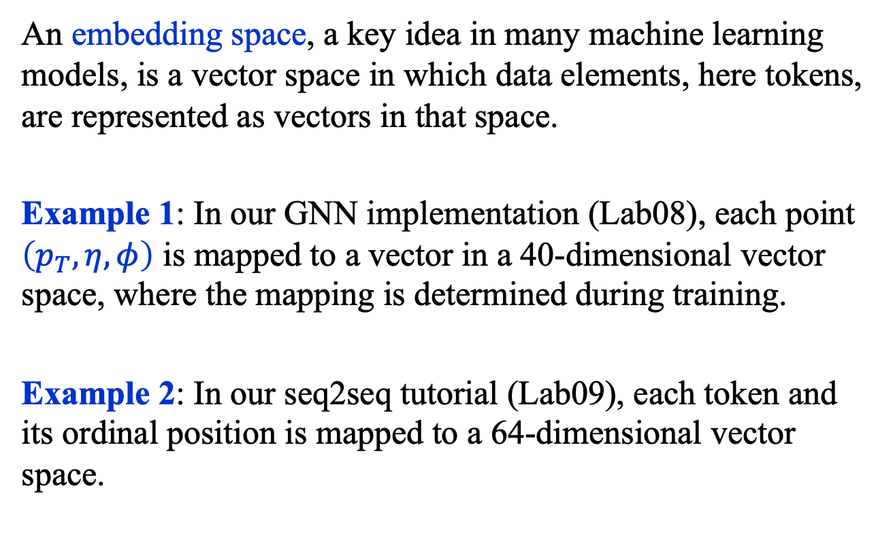
Seq2Seq: Embedding
An embedding space, a key idea in many machine learning models, is a vector space in which data elements, here tokens, are represented as vectors in that space.
Example 1: In our GNN implementation (Lab08), each point $\left(p_{T},η, φ\right)$ is mapped to a vector in a 40-dimensional vector space, where the mapping is determined during training.
Example 2: In our seq2seq tutorial (Lab09), each token and its ordinal position is mapped to a 64-dimensional vector space.

Slide 12
Seq2Seq: Analysis/Synthesis
Seq2seq models, like recurrent neural networks (RNN), long short-term memories (LSTM), and transformer neural networks (TNN) – the subject of today’s lecture – analyze and synthesize sequences in different ways.
Moreover, some classes of seq2seq models (e.g., RNN, LSTM) analyze sequences one token at a time.
Transformers were a breakthrough, in part, because tokens are analyzed in parallel.

Slide 13
Transformer Neural networks

Slide 14
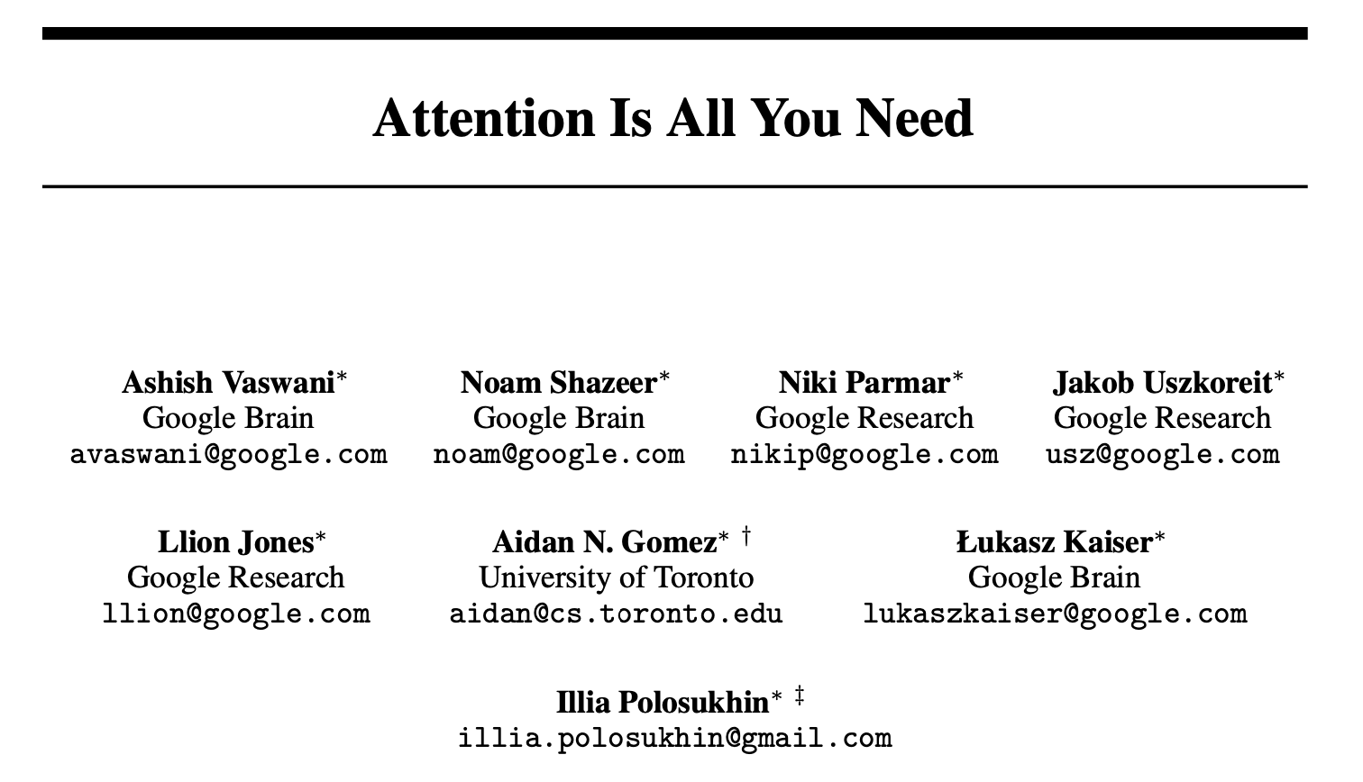
Attention Is All You Need
In 2017, in a seminal paper: https://arxiv.org/abs/1706.03762 Google researchers introduced a transformer neural network (TNN) with a highly successful analysis and synthesis method.

Slide 15

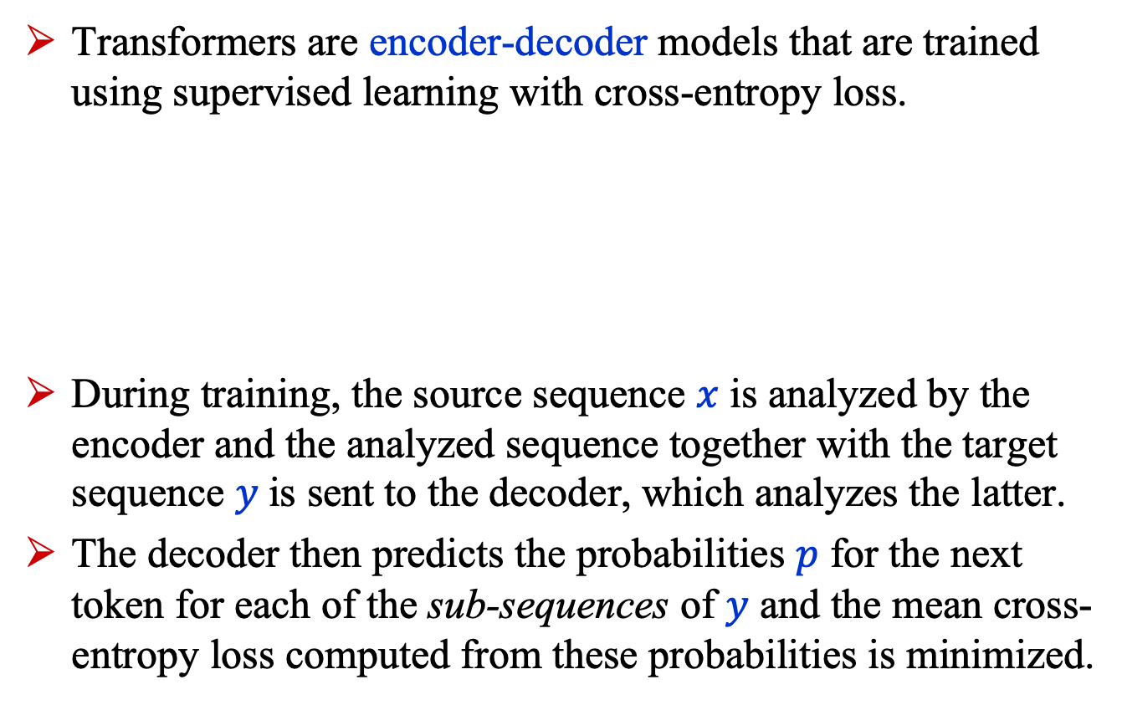
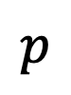
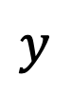
The Transformer
Transformers are encoder-decoder models that are trained using supervised learning with cross-entropy loss.
During training, the source sequence $x$ is analyzed by the encoder and the analyzed sequence together with the target sequence $y$is sent to the decoder, which analyzes the latter.
The decoder then predicts the probabilities $p$ for the next token for each of the sub-sequences of $y$ and the mean cross-entropy loss computed from these probabilities is minimized.
$$x$$
Encoder
Decoder
$$p$$
$$y$$

Slide 16

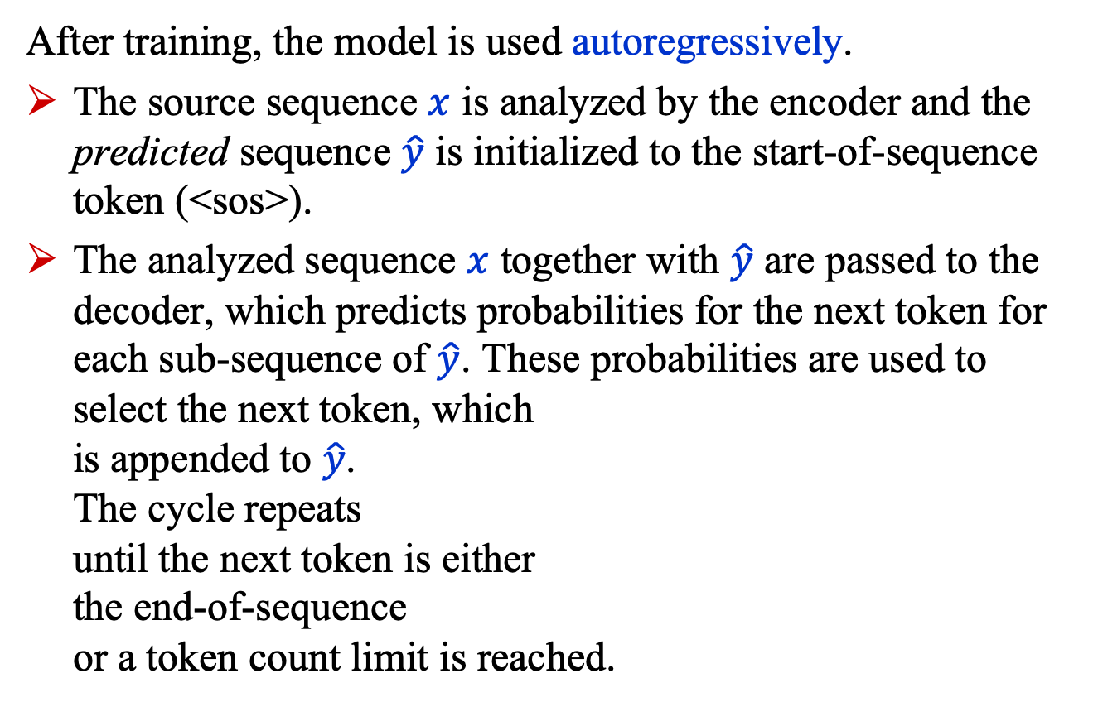
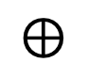
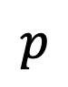
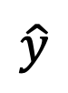
The Transformer
After training, the model is used autoregressively.
The source sequence $x$ is analyzed by the encoder and the predicted sequence $\hat{y}$ is initialized to the start-of-sequence token (<sos>).
The analyzed sequence $x$ together with $\hat{y}$ are passed to the decoder, which predicts probabilities for the next token for each sub-sequence of $\hat{y}$. These probabilities are used to select the next token, which is appended to $\hat{y}$. The cycle repeats until the next token is either the end-of-sequence or a token count limit is reached.
$$x$$
Encoder
Decoder
$$p$$
$$\hat{y}$$
$$⊕$$

Slide 17
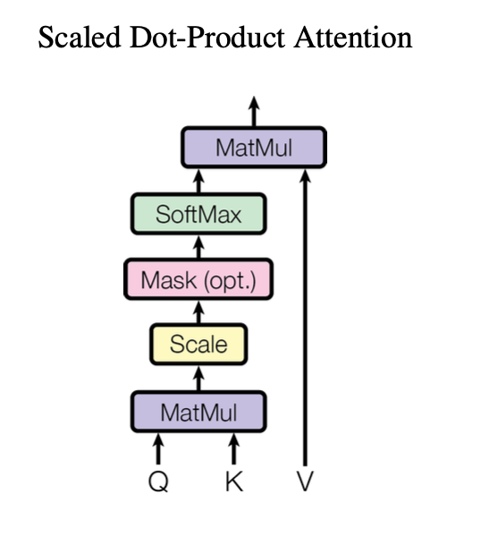

Attention
At the heart of Google’s breakthrough transformer model is the following expression
$$\text{Attention}\left(Q, K, V\right)$$
$$=\text{Softmax}\left(\frac{QK^{T}}{\sqrt{d}}\right)V$$
which captures some notion of a token “paying attention to” other tokens.
Q: query, K: key, V: value
https://arxiv.org/abs/1706.03762

Slide 18
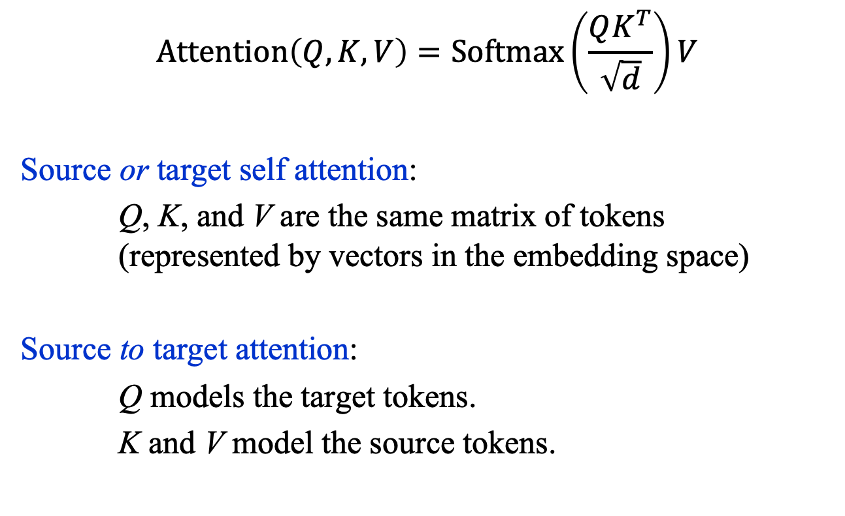
Attention
$$\text{Attention}\left(Q, K, V\right)=\text{Softmax}\left(\frac{QK^{T}}{\sqrt{d}}\right)V$$
Source or target self attention:
Q, K, and V are the same matrix of tokens (represented by vectors in the embedding space)
Source to target attention:
Q models the target tokens.
K and V model the source tokens.

Slide 19
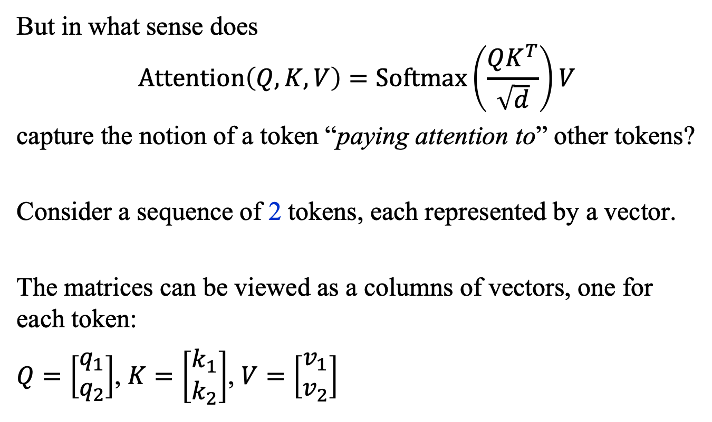
Attention: Token Vectors
But in what sense does
$$\text{Attention}\left(Q, K, V\right)=\text{Softmax}\left(\frac{QK^{T}}{\sqrt{d}}\right)V$$
capture the notion of a token “paying attention to” other tokens?
Consider a sequence of 2 tokens, each represented by a vector.
The matrices can be viewed as a columns of vectors, one for each token:
$Q=\left[\begin{matrix}q_{1} \\ q_{2}\end{matrix}\right]$, $K=\left[\begin{matrix}k_{1} \\ k_{2}\end{matrix}\right]$, $V=\left[\begin{matrix}v_{1} \\ v_{2}\end{matrix}\right]$

Slide 20
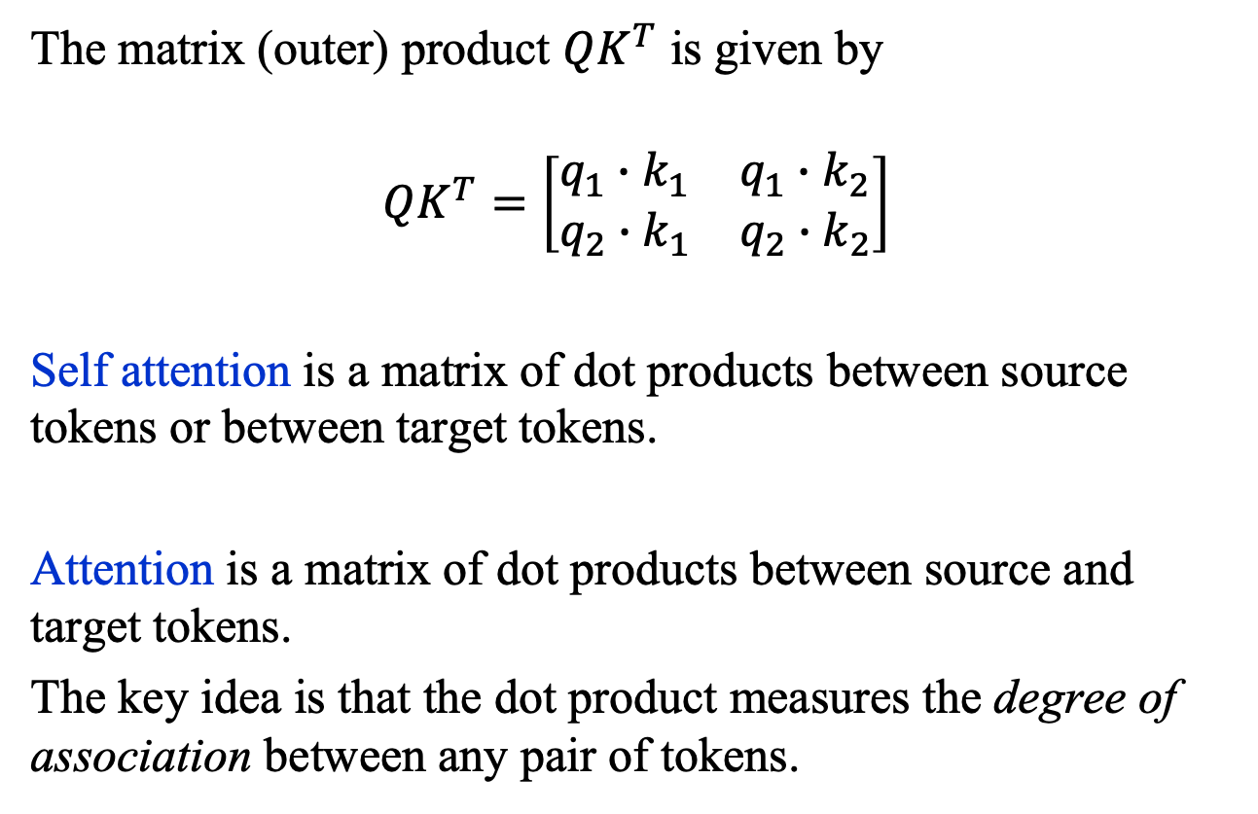
Attention: Dot Products
The matrix (outer) product $QK^{T}$ is given by
$$QK^{T}=\left[\begin{matrix}q_{1}∙k_{1} & q_{1}∙k_{2} \\ q_{2}∙k_{1} & q_{2}∙k_{2}\end{matrix}\right]$$
Self attention is a matrix of dot products between source tokens or between target tokens.
Attention is a matrix of dot products between source and target tokens.
The key idea is that the dot product measures the degree of association between any pair of tokens.

Slide 21
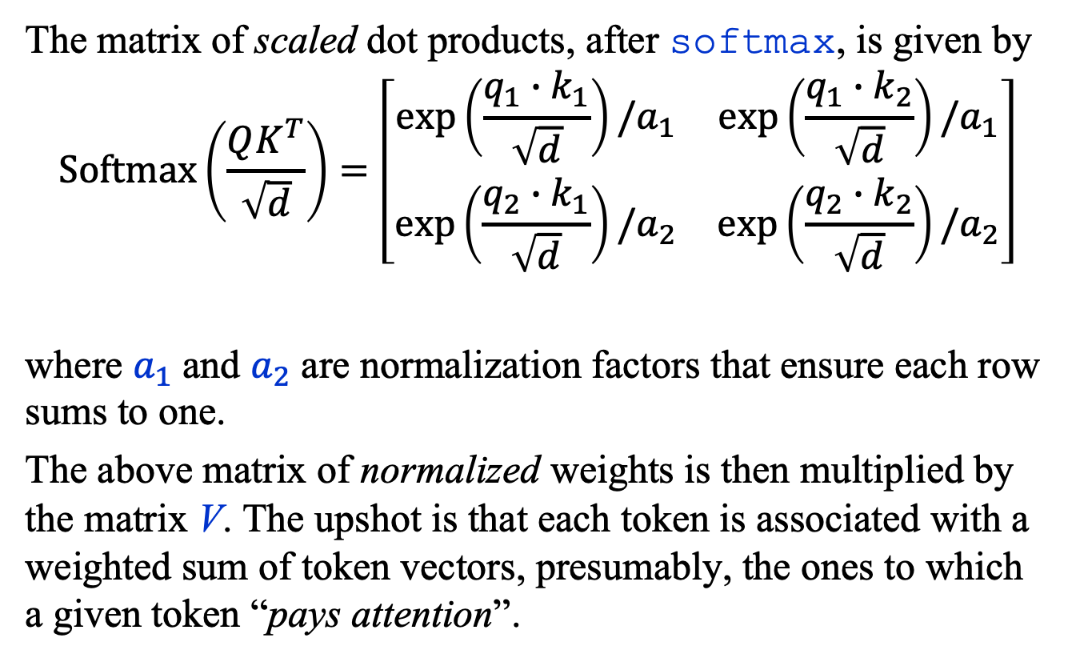
Attention: Scaled Dot Products
The matrix of scaled dot products, after softmax, is given by
$$\text{Softmax}\left(\frac{QK^{T}}{\sqrt{d}}\right)=\left[\begin{matrix}\exp\left(\frac{q_{1}∙k_{1}}{\sqrt{d}}\right)/a_{1} & \exp\left(\frac{{q_{1}∙k}_{2}}{\sqrt{d}}\right)/a_{1} \\ \exp\left(\frac{{q_{2}∙k}_{1}}{\sqrt{d}}\right)/a_{2} & \exp\left(\frac{{q_{2}∙k}_{2}}{\sqrt{d}}\right)/a_{2}\end{matrix}\right]$$
where $a_{1}$ and $a_{2}$ are normalization factors that ensure each row sums to one.
The above matrix of normalized weights is then multiplied by the matrix V. The upshot is that each token is associated with a weighted sum of token vectors, presumably, the ones to which a given token “pays attention”.

Slide 22
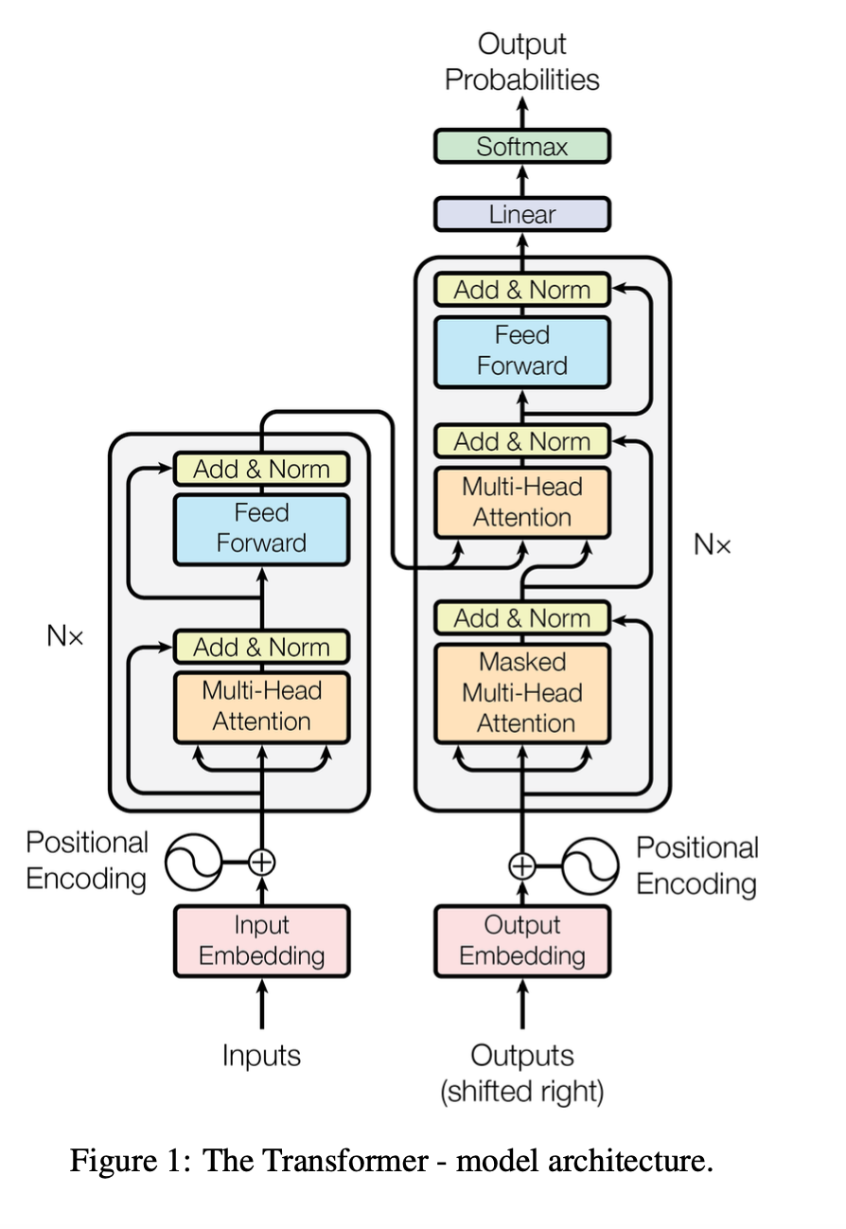
Transformer: Some Details
The transformer is a rather complicated
function as is evident from this figure
from the 2017 Google
paper.
But let’s work through it
step by step. (Details can
be found in Lab09)

Slide 23
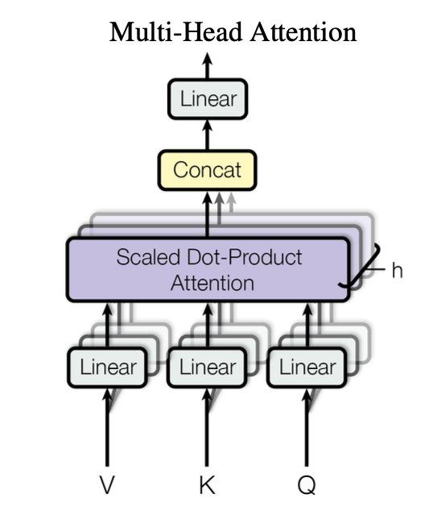
Transformer: Some Details
The key component of this function is the
so-called multi-head attention.

Slide 24
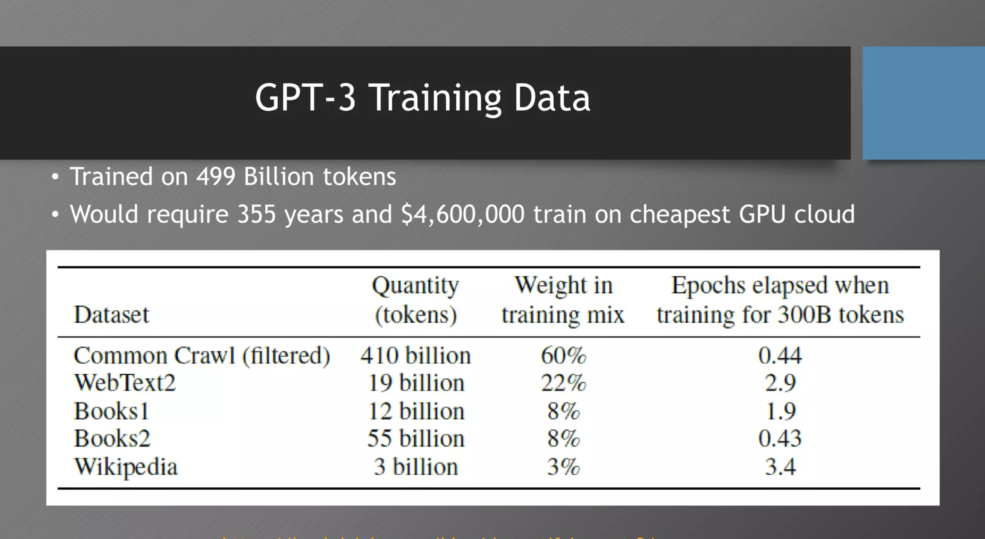
Transformer: ChatGPT
The GPT version 3 Training Data
Credit: Steve Omohundro / OpenAI
https://steveomohundro.com/
https://chat.openai.com/c/6ac10f83-6693-43c9-9825-8f143f7006bc

Slide 25
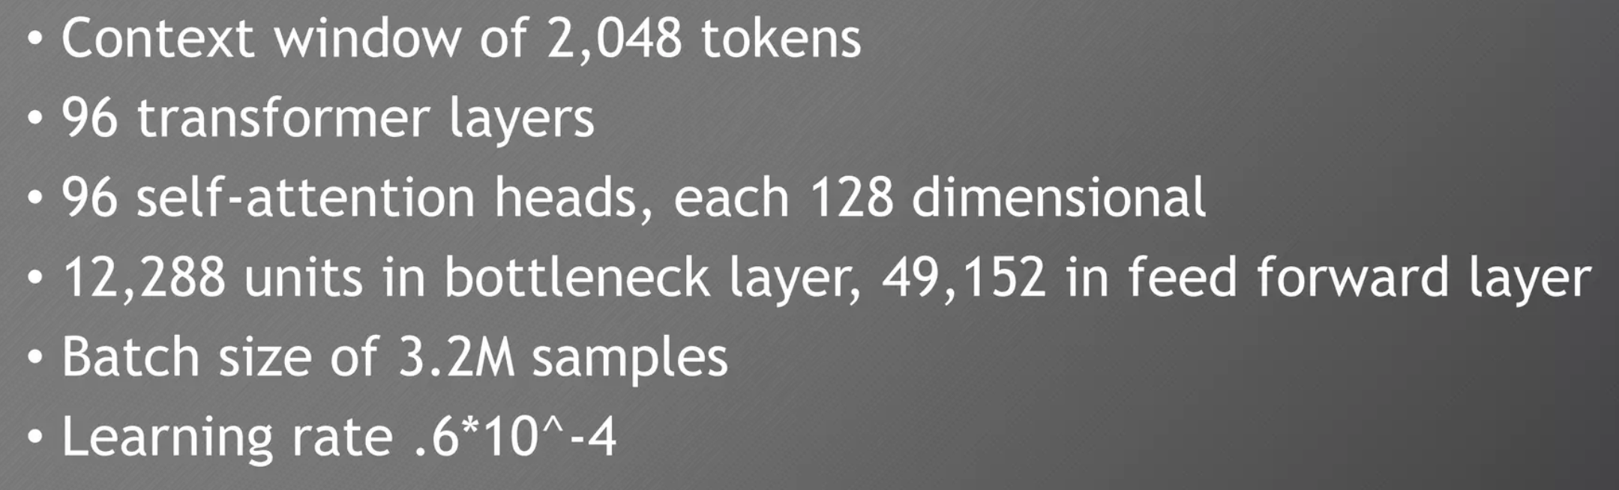
Transformer: ChatGPT
The GPT version 3 model that underlies the chatbot ChatGPT is a function with 175 billion parameters!
Credit: Steve Omohundro / OpenAI
https://steveomohundro.com/
https://chat.openai.com/c/6ac10f83-6693-43c9-9825-8f143f7006bc

Slide 26
Summary
The transformer neural network has revolutionized large-language models (LLM), such as the one that underpins the chatbot ChatGPT.
Advantages
All tokens processed simultaneously during training.
Attention makes it possible to handle much longer sequences than was possible in previous models.
Disadvantages
Complexity
Training time

